Slide 1
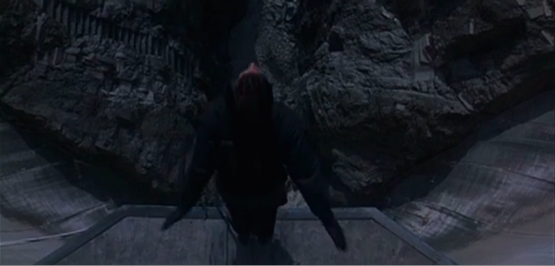
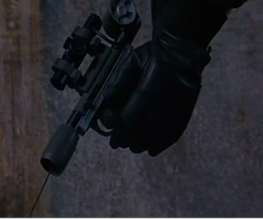
Could Bond Hold On?
m_{B} = 100 kg
Bungee cords stretch 3-4x their length, assume 4x
L – length
of bungee
L = 220/4 = 55 m, x = 220 – 55 =165 m
Find k, force constant of bungee
Find T, force from Bond’s hand
FBD of Bond:
220 m
x – bungee
stretch
distance
+
F = kx
T
mg
Low, but Q could make one!
Conclusion: Yes, but would that little hook hold?

Slide 2
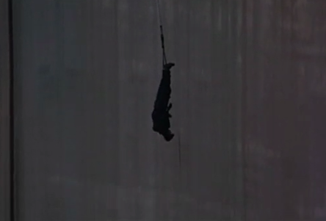
More Bond Bungee Analysis
m = 100 kg
L = 55 m
What was Bond’s Maximum Velocity? (Ignore Air Resistance)
When did Bond Have Max velocity?
A. Before the bungee stretched
B. Just as bungee started stretching
C. After bungee started stretching
Maximum velocity occurs when acceleration is zero
L – length
of bungee
Bond does NOT start to slow down until bungee pulls up more than gravity pulls down
+
F = kx
220 m
x – bungee
stretch
distance
http://youtu.be/zJ6Hy4ISq6I
mg
Maximum velocity occurs when bungee has stretched 61.25 m

Slide 3
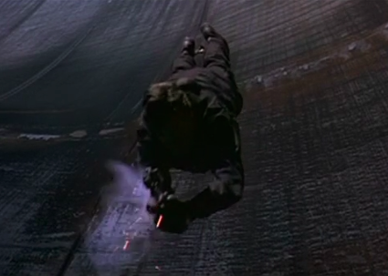
More Bond Bungee Analysis
k = 16 N/m
m = 100 kg
How did Q Calculate x given L?
L = 55 m
h = L + x
What is h?
A. h = x
B. h = L
C. h = L + x
D. h = L - x
220 m
x = ?
More U_{g} goes into U_{E} as bungee stretches and Bond falls further

