Slide 1
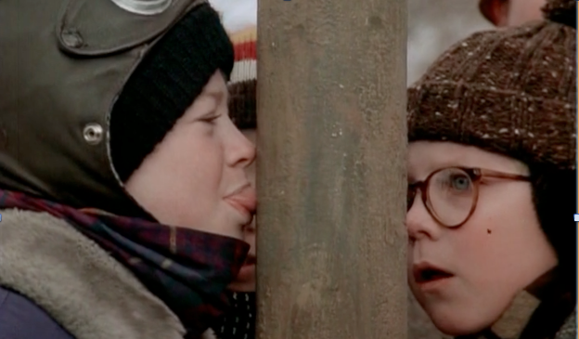
Which of the following statements about the kid stuck to the metal flagpole are true?
I. More heat is transferred from the saliva to the pole than from the tongue to the saliva.
II. The temperature of the pole must be less than the freezing temperature of saliva.
III. The same thing would happen with a wooden pole.
I only.
II only.
I and II only.
I and III only.
I, II, and III.

