Slide 1
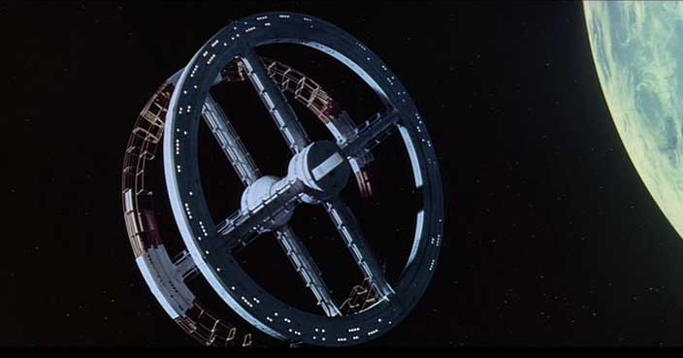
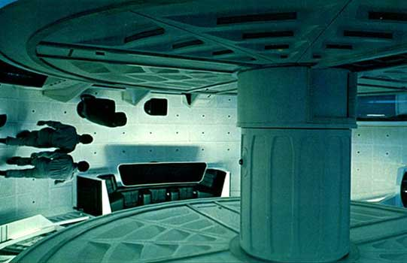
Artificial Gravity
For Earth Gravity:
r = 100m
ω = ?
N

Slide 2
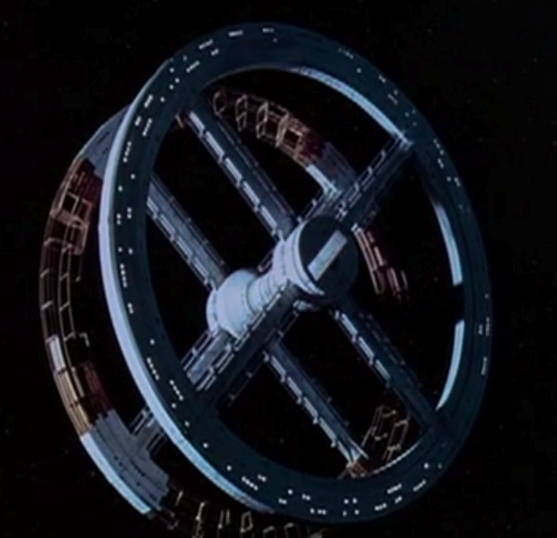
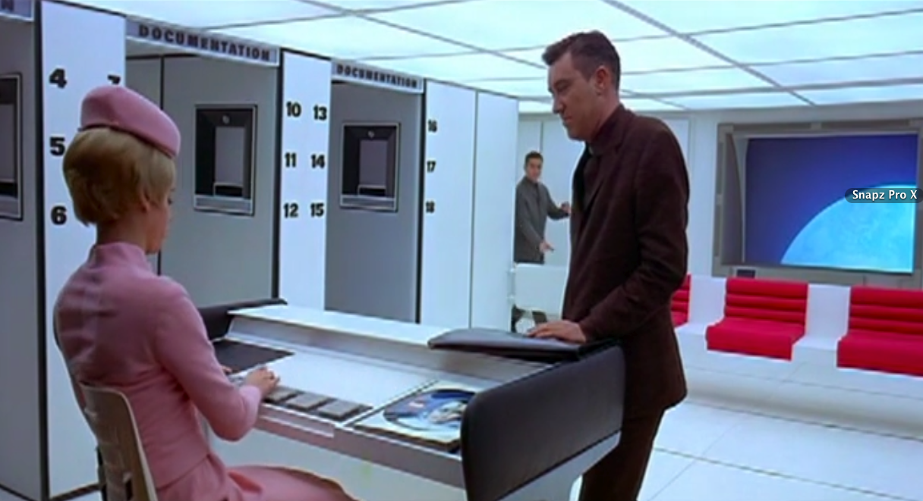
2001: A Space Odyssey
What is the artificial gravity level on the Space Station?
Height of Window = 1.2m
Radius = 50 Window Heights = 60m
Rotation Period = 32s (Average of 3)
ω = 2π/Τ = 0.2 rad/s
Acceleration = ω²r = 2.3 m/s²
Acceleration less than Mars, greater than Moon. It may be sufficient to counter effects of normalforcelessness

Slide 3
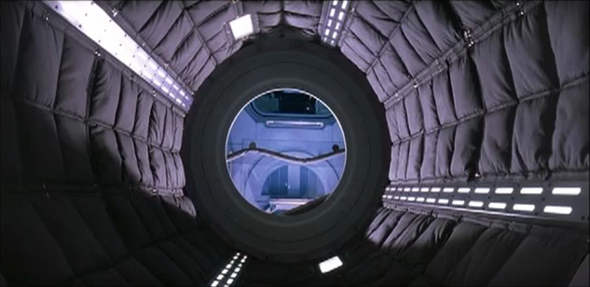
Mission to Mars
What is artificial gravity level on Mission to Mars Movie spacecraft?

Slide 4
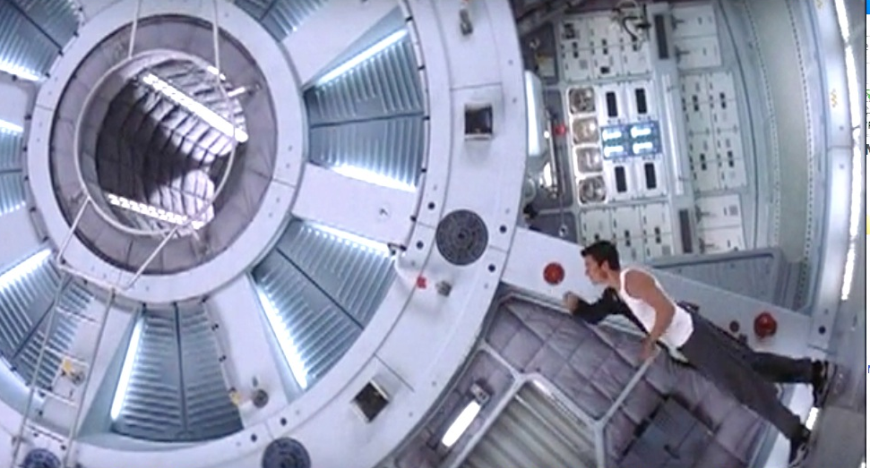
Mission to Mars
What is artificial gravity level on the ship?
Height of Astronaut = 1.8 m
Radius = 2.5 Astronauts = 4.5 m
Time for 3/8 of a Rotation = 10.9 s
Time for 1 Rotation (Τ) = 29 s
ω = 2π/Τ = 0.22 rad/s
Acceleration (Feet) = ω²r = 0.22 m/s²
Acceleration (Head) = ω²r = 0.13 m/s²
r
ω
Acceleration is too small to help astronauts, difference could produce nausea

