Slide 1
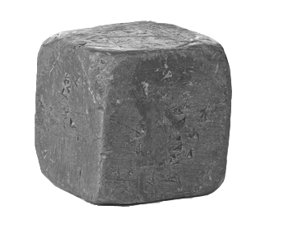
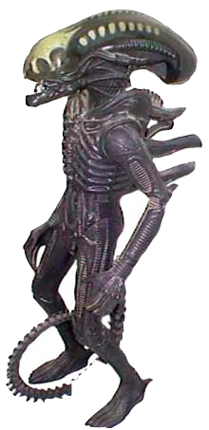
Pour 5000 kg of lead at 400 Cº onto a 600 kg alien at 20 Cº. What is the final temperature of the lead/alien mixture?

Slide 2
How much of the 5000 kilograms of lead froze?

Slide 3
What happens when you pour cold water on a hot alien?
Its volume will increase proportional to the change in temperature.
Its volume will decrease proportional to the change in temperature.
Its volume will increase proportional to the volume of the alien.
Its volume will not change.
It will explode.

Slide 4
What happens when you pour cold water on a hot alien?
Its volume will increase proportional to the change in temperature.
Its volume will decrease proportional to the change in temperature.
Its volume will increase proportional to the volume of the alien.
Its volume will not change.
It will explode.

