Slide 1
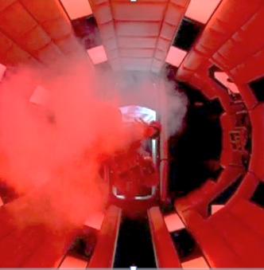
Assume the spacehip had a volume of
4 m³, pressure of 1 atm, and a temperature of 16 C^{o.} Assume the airlock has a volume of 12 m³, the process is adiabatic, and none of the air is lost to space. How many moles of air were in the spaceship?
What is the airlock pressure if process was isothermal?
Could this adiabatic process be isothermal?

Slide 2
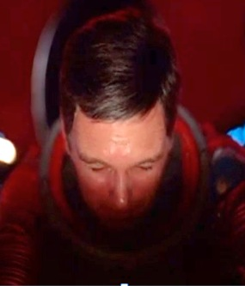
Complete the PV diagram for Dave’s Airlock Entry
Volume (m³) | Pressure (atm)
4 | 1
5
8
10
12
16 | 0.25
0.8
0.5
0.4
0.33
Why do you think Dave closed his eyes before going?
Could Dave survive this experience?
Probably, see: http://www.uh.edu/engines/epi2691.htm

