Slide 1
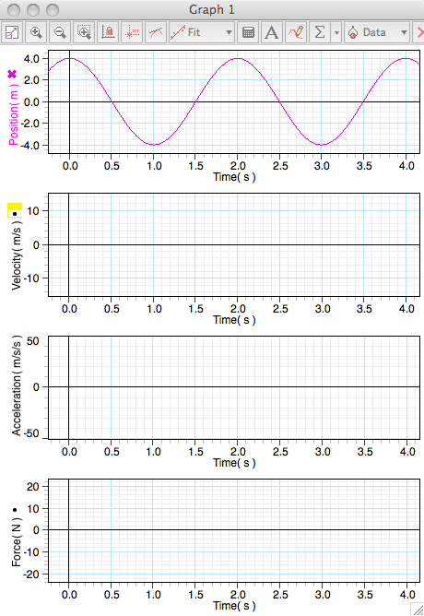
SHM Kinematics
What is the Frequency?
m = 0.5 kg
What is the Period?
What is the Angular Frequency?
What is the Amplitude?
What function is x(t)?
What function is v(t)?
What is V_{m}?

Slide 2
SHM Kinematics
m = 0.5 kg
What function is a(t)?
What is a_{m}?
What function is F(t)?
What is F_{m}?

Slide 3
SHM Kinematics
m = 0.5 kg

Slide 4
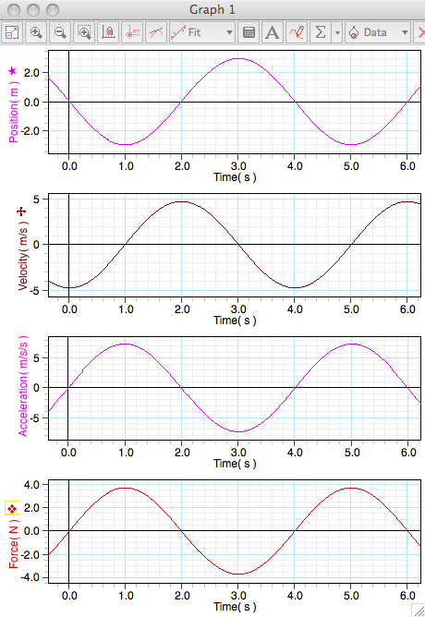
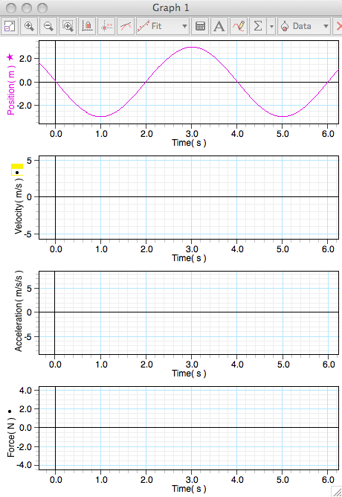
SHM Kinematics
Can you determine the equations for v(t), a(t), and F(t)? Give it a try!
m = 0.5 kg
I said no cheating!

