Slide 1
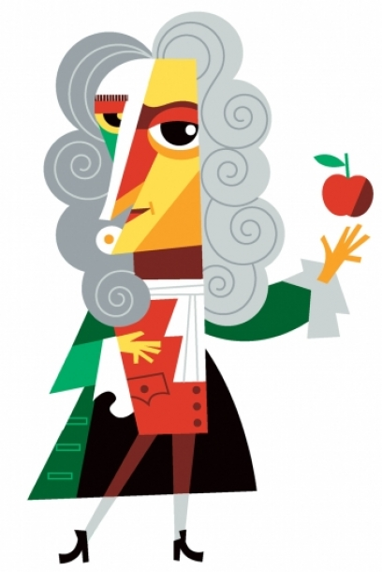
Newton’s Third Law
If Object A Exerts a Force on Object B, then Object B Exerts an Equal, Oppositely Directed, and Simultaneous Force on Object A
For Every Action There is an Equal and Opposite Reaction

Slide 2
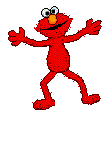
If your feet push down on the floor, what does the floor do?
Nothing
Absorbs the push
Pushes up on your feet, but with less force
Pushes up on your feet with an equal force
Pushes up on your feet with greater force
Newton 3

Slide 3
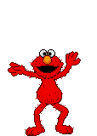
Can the floor push up on your feet with a force greater than your weight?
Yes, but nothing will happen
Yes, you will accelerate up into the air
No, it always equals your weight
No, it can only equal or be less than your weight
Yes, but only on a planet with stronger gravity
Newton 3

Slide 4
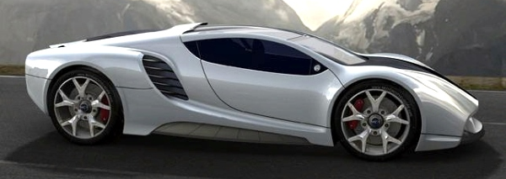
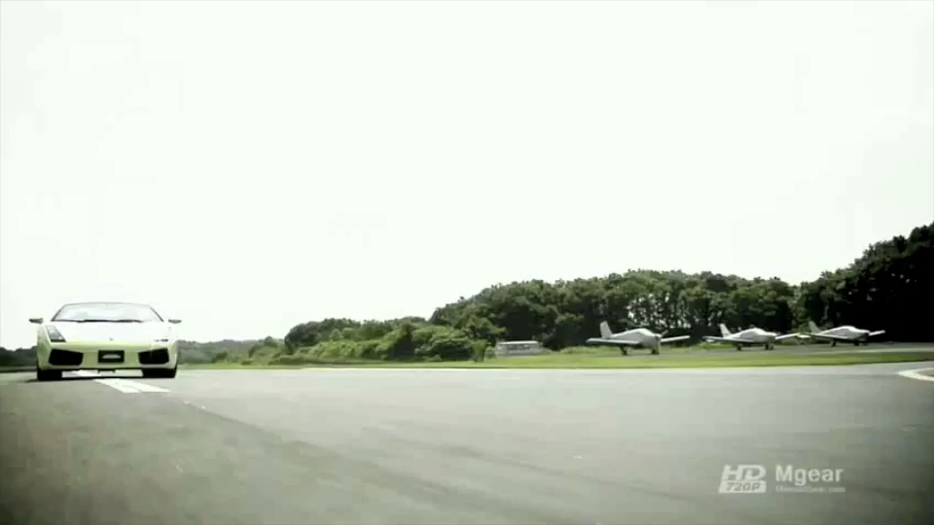
What is the force from that causes a car to accelerate down the road?
The engine
The transmission
The pistons
The road
The tires
Newton 3

Slide 5
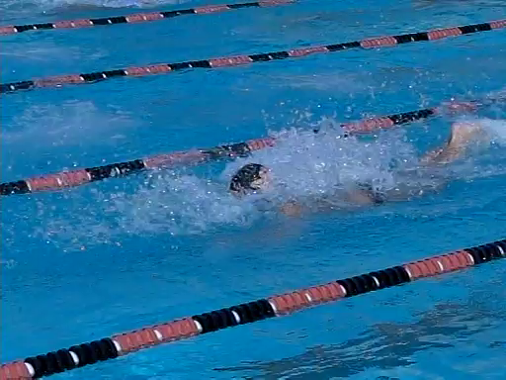
What is the force from that causes a swimmer to accelerate across a pool?
The swimmer’s legs
The swimmers arms
The swimmer’s arms and legs
Gravity
The water
Newton 3

Slide 6
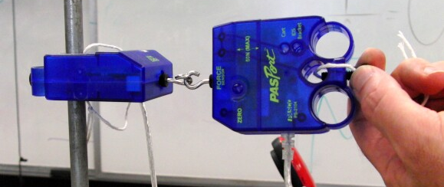
Which force probe will measure the greatest force?
The one pulled by the teacher
The one attached to the ring stand
Both will measure the same force
Either one depending on how the teacher pulls
Newton 3

Slide 7
The Earth pulls on the Moon with gravity, causing it to orbit. What does the Moon do to the Earth?
Pulls on the Earth with equal gravity, causing it to orbit
Nothing, it is too small
Pulls on the Earth with less gravity, having no effect
Pulls on the Earth with less gravity, causing tides
Newton 3

Slide 8
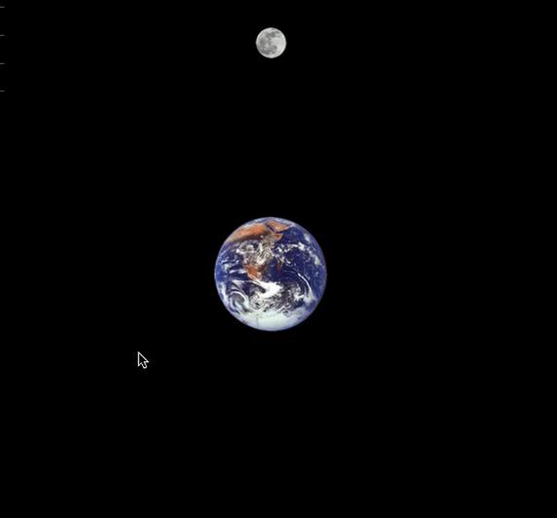
The Earth orbits a point about ¾ of the distance from its center to its surface (not to scale)

Slide 9
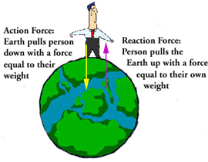
The Earth pulls on you with the force of gravity, what is the reaction to this force?
Normal force
You pull on the Earth with an equal force of gravity
You pull on the Earth with a smaller force of gravity
Nothing, only the Earth has gravity
Newton 3

Slide 10
The Forces are the same but the Masses and Accelerations are different
M_{Earth}
F
= ª_{Earth}
F
= a_{Person}
M_{Person}

Slide 11
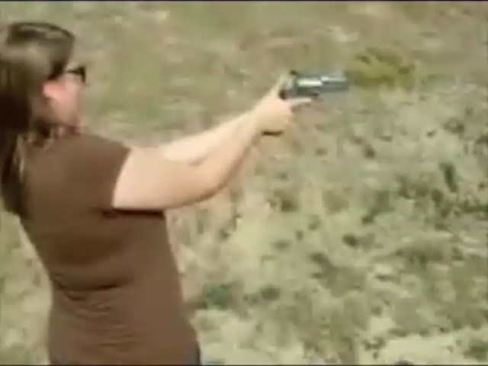
A gun shoots a bullet, which received the greatest force?
The bullet
The gun
Each received an equal force
Depends on the size of the bullet
Newton 3

Slide 12
The Forces are the same but the Masses and Accelerations are different
M_{Gun}
F
= ª_{Gun}
F
= a_{Bullet}
M_{Bullet}

Slide 13
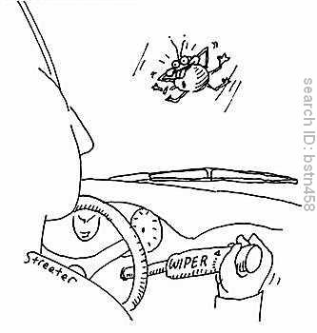
A bug splatters on a windshield, which received the greatest force?
The windshield
The bug
Each received an equal force
Depends on the size of the bug
Newton 3

Slide 14
The Forces are the same but the Masses and Accelerations are different
M_{Car}
F
= ª_{Car}
= a_{Bug}
F
M_{Bug}

Slide 15
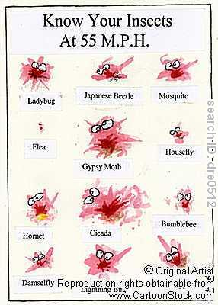
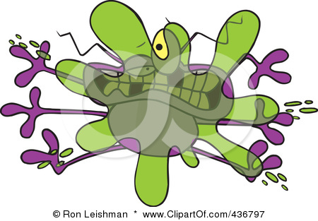
What was the last thing to go through the bug’s mind?
His Butt!

Slide 16

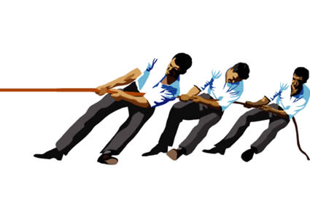
In the tug-of-war, what is the reading on the scale?
1000 N
1000 N
0
3000
1000
2000
0 N
1000 N
2000 N
3000 N

Slide 17
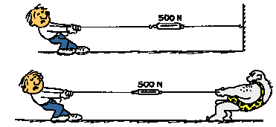
The tree pulls just like the tug-of-war team. If the pull is only from one side, the tension is zero.

Slide 18
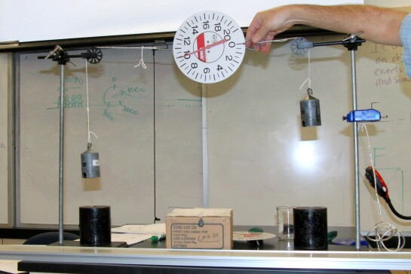
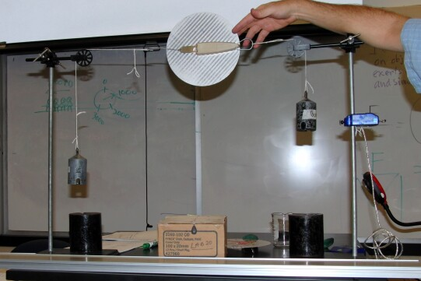
What will the scale read that is pulled from both sides by 10 N weights?
0 N
10 N
20 N
30 N

Slide 19
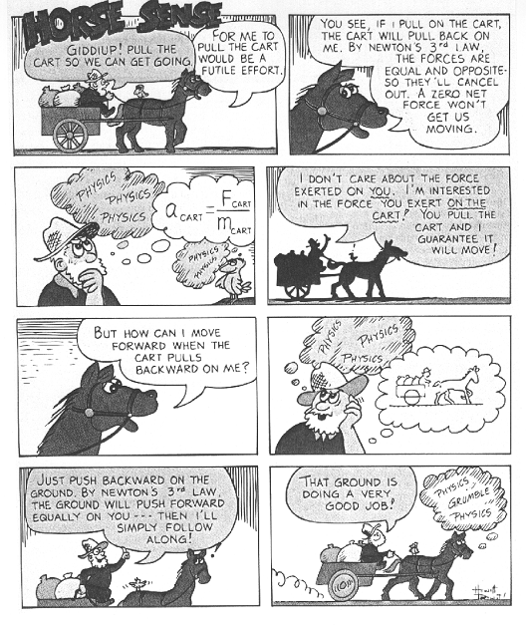

Slide 20
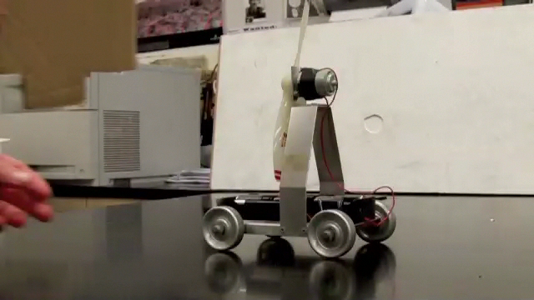
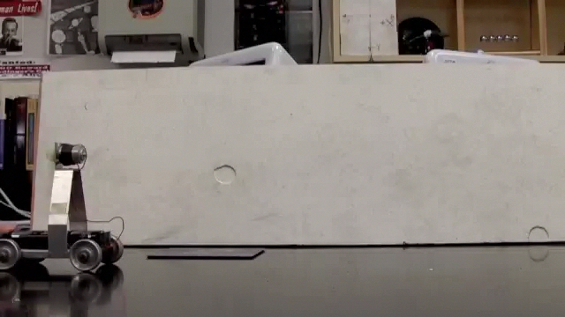
What will be the effect of adding a sail to the fan cart?
Slower
Faster
No effect
First faster, then slower
First slower, then faster

Slide 21
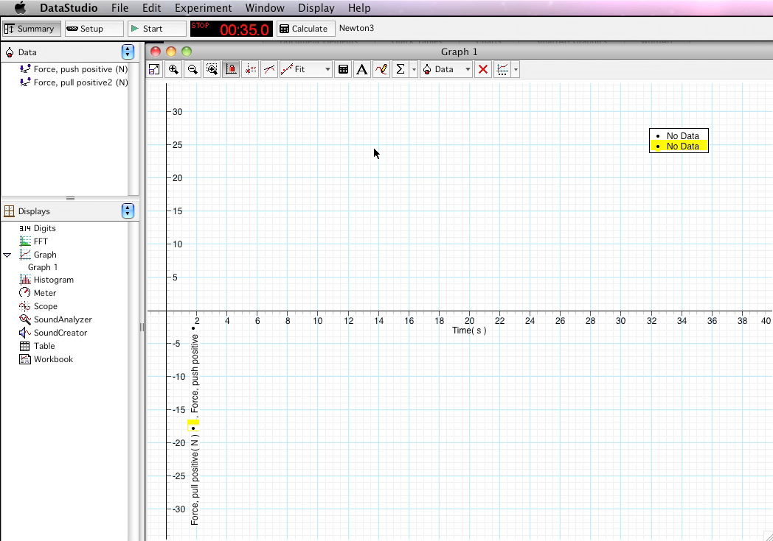
Which force probe will measure the greatest force?

Slide 22
Newton’s Third Law
If Object A Exerts a Force on Object B, then Object B Exerts an Equal, Oppositely Directed, and Simultaneous Force on Object A
Return

