Slide 1
Newton’s 2nd Law of Motion:
Newton’s 2nd Law of Rotation:

Slide 2
Free Body Diagrams for Rotation
Draw the object as simple as possible.
Draw and label all forces acting ON the object. Make sure each force originates at its point of application and weight vectors start at center of mass of object
Indicate coordinate system and the axis of rotation including direction of positive rotation (usually counter-clockwise)
Write Newton’s Second Law of rotation (and ΣF=ma if necessary) and substitute torques and rotational inertia.
Solve for unknowns

Slide 3
Free Body Diagrams for Rotation
A mass m is attached to a rod with length l of negligible mass that is free to rotate about its end. It is released from rest, find α and the acceleration of the mass
N
+
mg

Slide 4
Find α and the acceleration of the mass when the rod is at an angle θ from the vertical (Neglect mass of rod)
N
+
θ
mg

Slide 5
Parallel Axis Theorem
The rotational inertia of an object is its rotational inertia about its center plus mh², where h is the distance from the center of the object to the rotation axis
The rotational inertia of a uniform rod about its center is:
Find its rotational inertia about its end.
CM
h

Slide 6
A meter stick free to rotate about one end with mass m is released from rest in a horizontal position. Find α and the acceleration of the end of the meter stick
N
+
mg
Can the acceleration be greater than 9.8 m/s² ???

Slide 7
Can the acceleration by greater than 9.8 m/s² ???
At what r does a=g?

Slide 8
A mass m is attached to a rod with length l and mass m that is free to rotate about its end. It is released from rest, find α and the acceleration of the mass
N
+
mg
mg

Slide 9
Derivation of Rotational Inertia of a Rod about its Center
x
dx
L/2
L/2
Limits are 0 to L

Slide 10
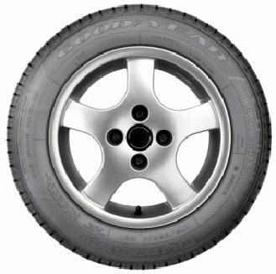
A wheel rolls by you at constant velocity. Which part of the wheel is moving the fastest?
the bottom
the center
the top
the point out in front
all points move with the same speed

Slide 11
Which part of the wheel is moving the slowest?
the bottom
the center
the top
the point out in front
all points move with the same speed

Slide 12
A Rolling Wheel is the Synthesis of a Rotating Wheel and a Translating Wheel
+
=
V = 0
V
V
Rotating
Wheel
Translating
Wheel
Rolling
Wheel

Slide 13
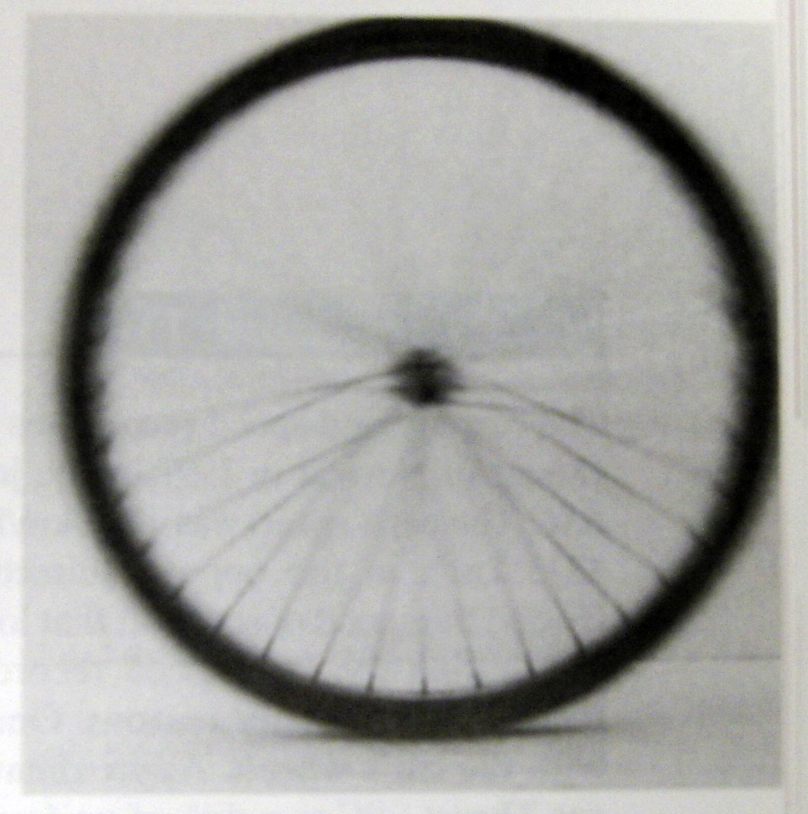
Long Exposure Photograph of Rolling Bike Wheel. Fastest Spokes are Blurred

Slide 14
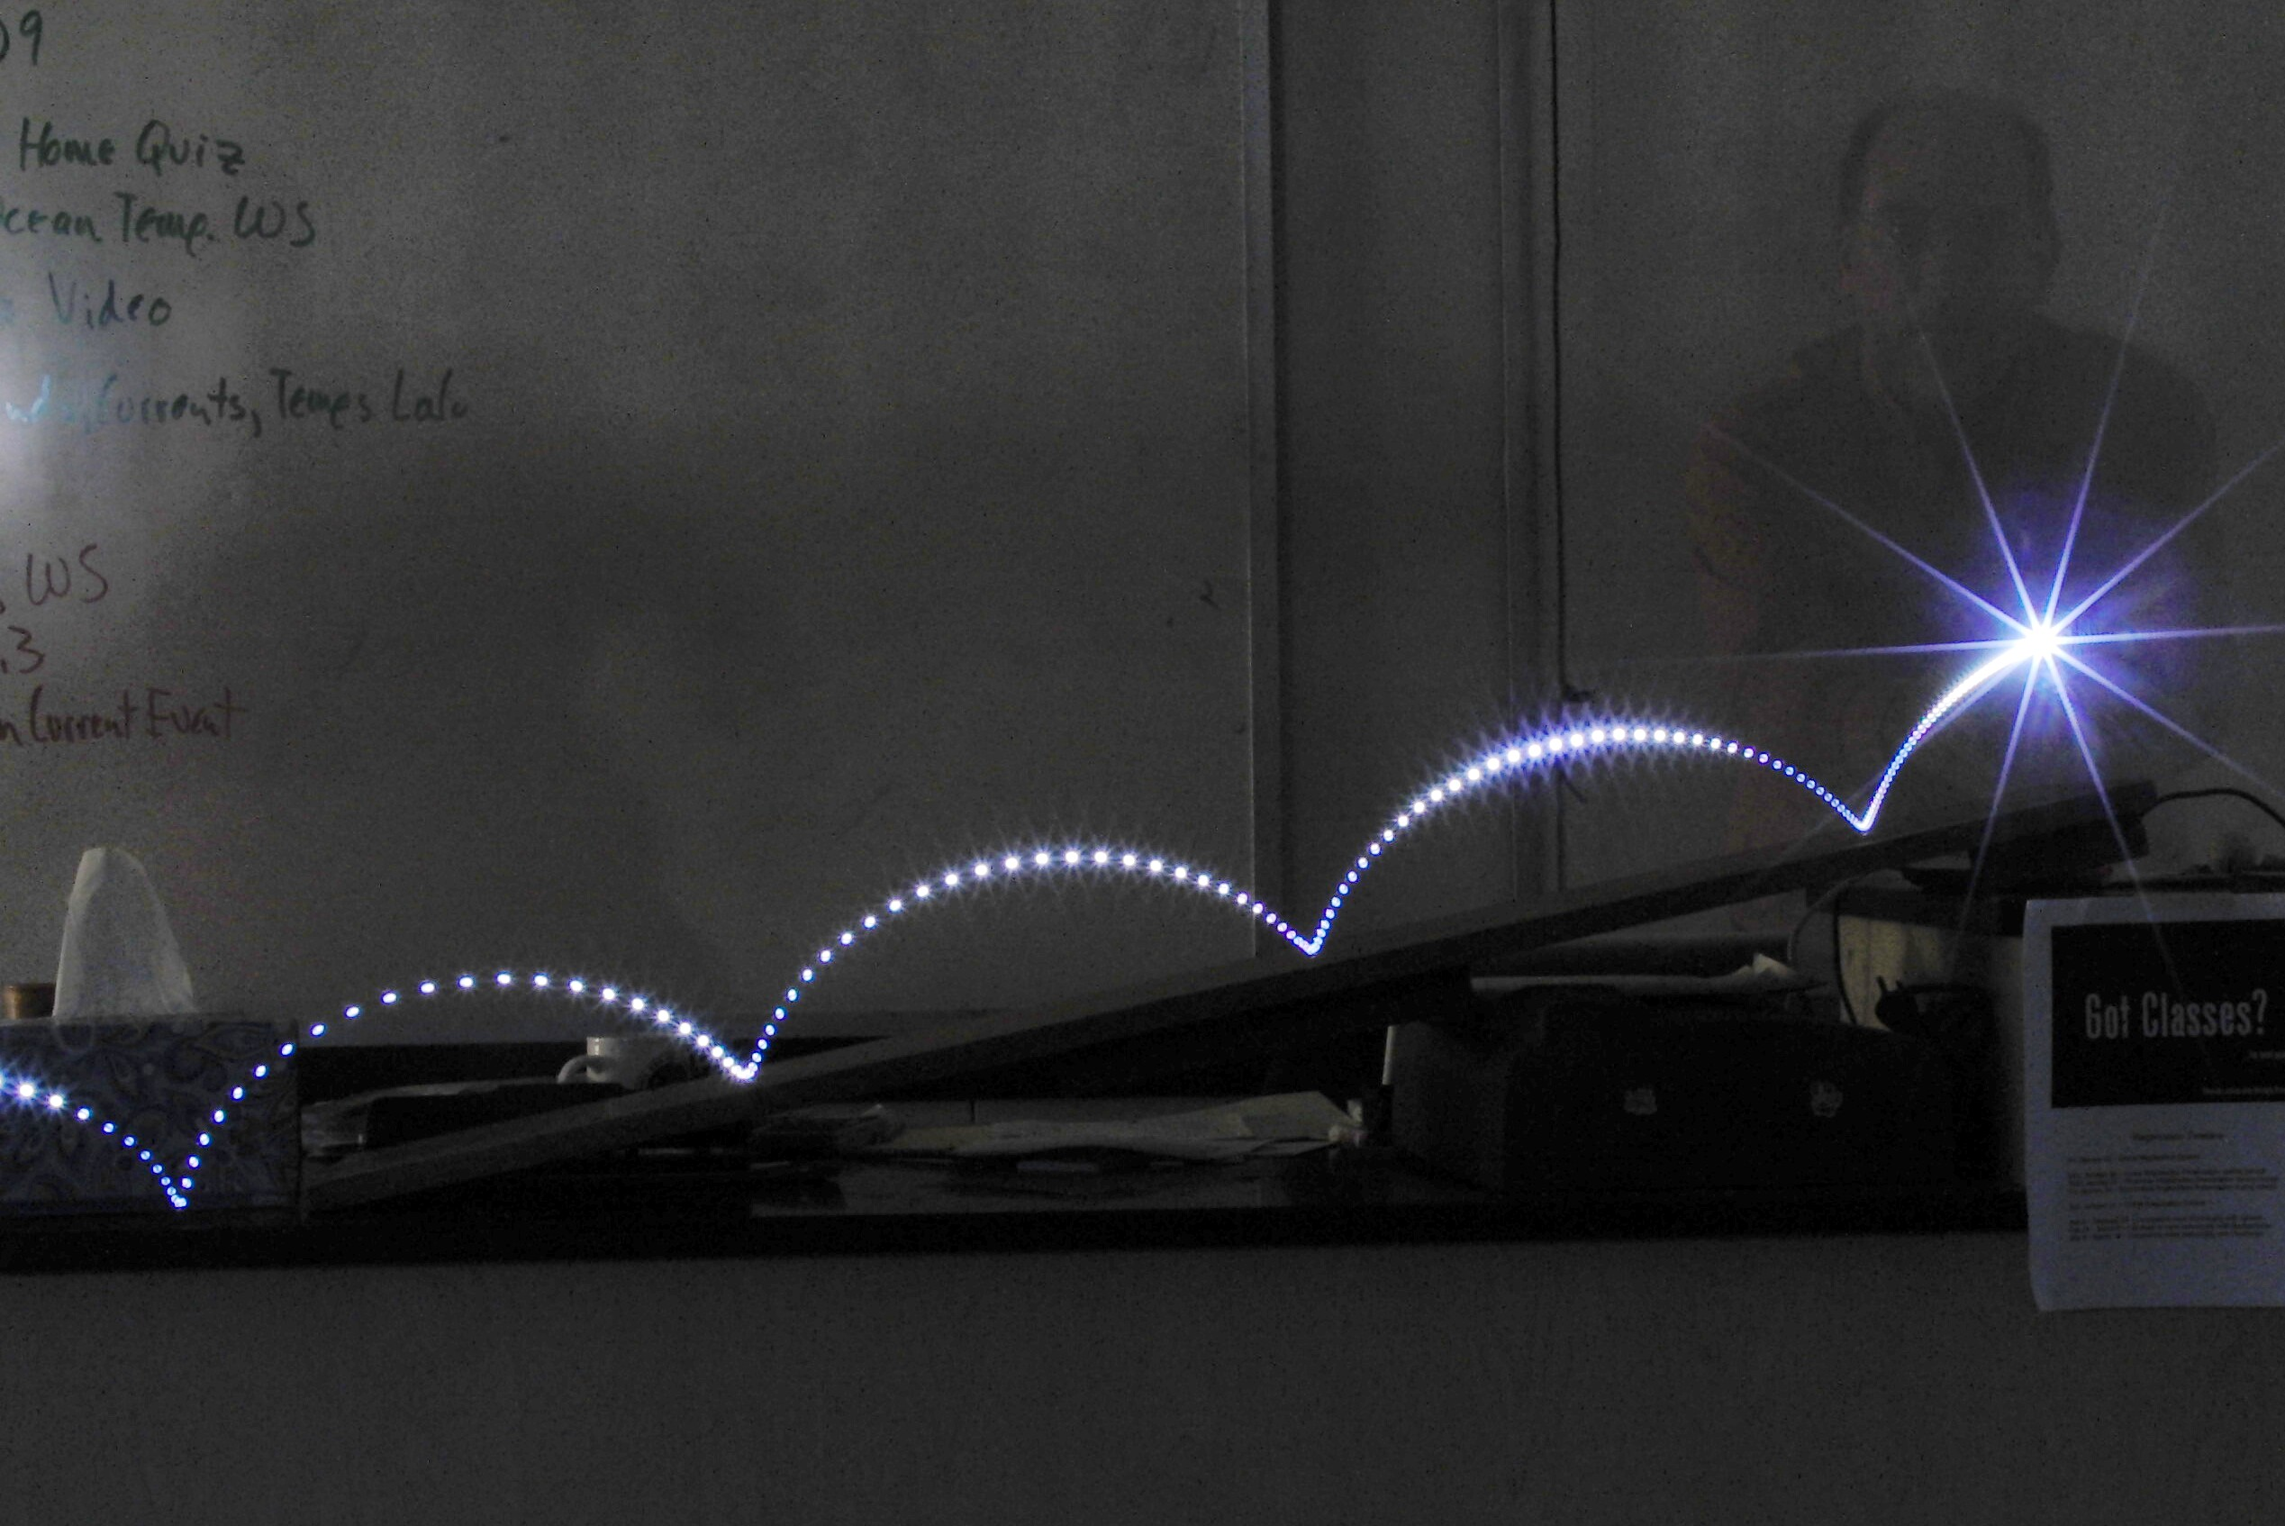
A Flashing LED is Attached to a Hollow Cylinder and Rolled Down a Ramp

Slide 15
Show that the acceleration of a hollow cylinder on a ramp is equal to:
θ
+y
+x

Slide 16
A solid cylinder of mass m and radius R has a string wound around it. A person holding the string pulls it vertically upward, as shown at right, such that the cylinder is suspended in midair for a brief time interval Δt and its center of mass does not move. The tension in the string is T, and the rotational inertia of the cylinder about its axis is:
1. The net force on the cylinder during the time interval Δt is
(A) T (B) mg (C) T - mgR (D) mgR - T (E) zero

Slide 17
A solid cylinder of mass m and radius R has a string wound around it. A person holding the string pulls it vertically upward, as shown at right, such that the cylinder is suspended in midair for a brief time interval Δt and its center of mass does not move. The tension in the string is T, and the rotational inertia of the cylinder about its axis is:
2. The linear acceleration of the person’s hand during the time interval Δt is
(A) (B) 2g (C) (D) (E) zero

Slide 18
3. Two blocks are joined by a light string that passes over the pulley shown below, which has radius R and moment of inertia I about its center. T₁ and T₂ are the tensions in the string on either side of the pulley and α is the angular acceleration of the pulley. Which of the following equations best describes the pulley's rotational motion during the time the blocks accelerate?
(A) m₂gR = Iα
(B) (T₁ + T₂)R = Iα
(C) T₂R = Iα
(D) (T₂ ‑ T₁)R = Iα
(E) (m₂ – m₁)gR = Iα

Slide 19
A wheel with rotational inertia I is mounted on a fixed, frictionless axle. The angular speed ω of the wheel is increased from zero to ω_{f} in a time interval T.
4. What is the average net torque on the wheel during this time interval?
5. What is the average power input to the wheel during this time interval?

Slide 20
6. A uniform stick has length L. The moment of inertia about the center of the stick is I_{o}. A particle of mass M is attached to one end of the stick. The moment of inertia of the combined system about the center of the stick is

Slide 21
7. A light rigid rod with masses attached to its ends is pivoted about a horizontal axis as shown above. When released from rest in a horizontal orientation, the rod begins to rotate with an angular acceleration of magnitude

Slide 22
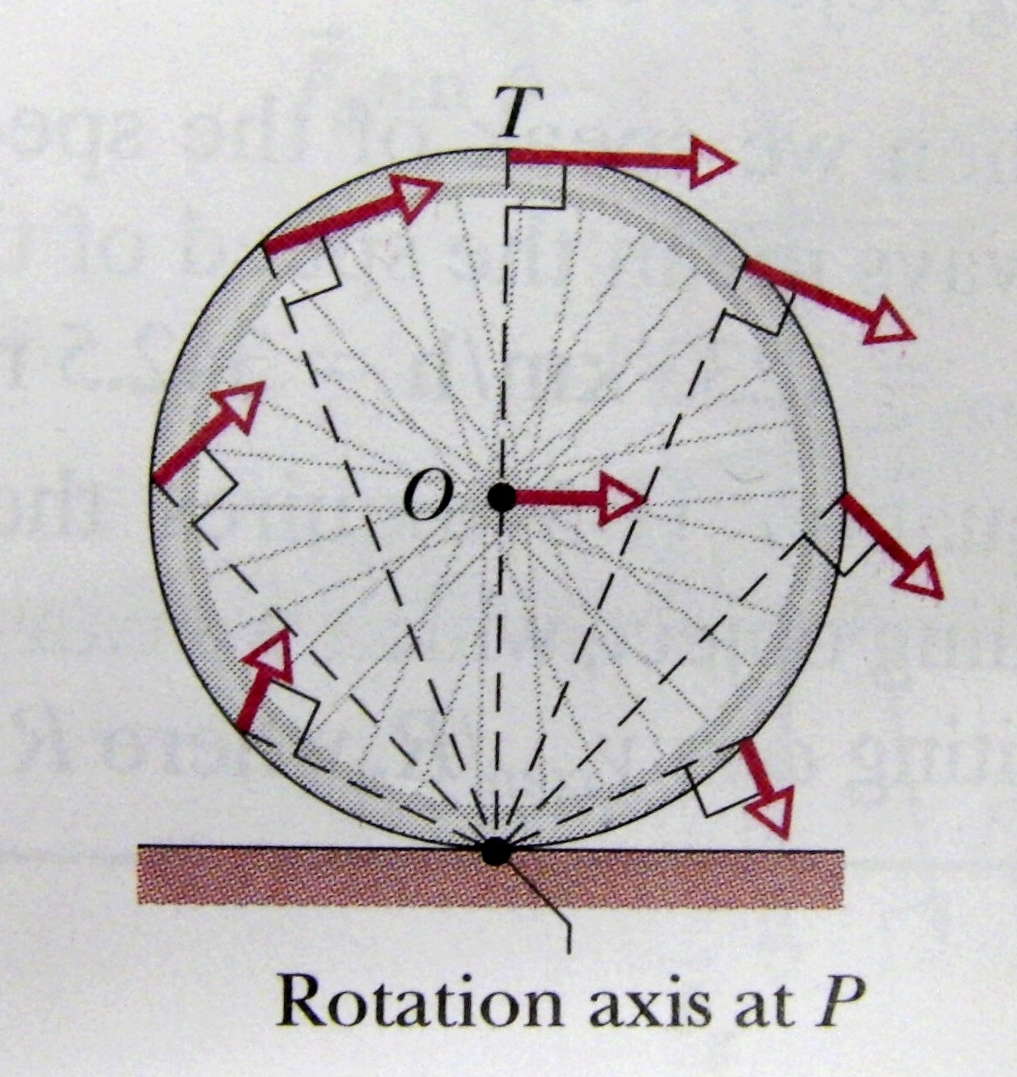
There are 2 ways of visualizing a rolling object, rotation and translation combined and pure rotation.
Rotation and translation analyzes rolling into 2 separate motions:
+
Pure rotation synthesizes these motions into 1 motion, an object trying to rotate about its contact point:

Slide 23
What is the rotational inertia of a hollow sphere rotating about a point on its surface if I about its center is:

Slide 24
Show that the acceleration of a hollow sphere on a ramp is equal to:
θ
Try summing the torques about the center to get the same result

