Slide 1
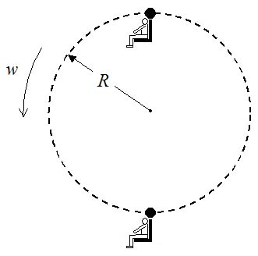
Vertical Circular Motion – Ferris Wheel
m = 50 kg, R = 15 m, ω = 3 rev/min (RPM)
What is the Normal force on the rider at the top and at the bottom?
N
At Top:
+y
mg
At Bottom:
At what ω would rider lose contact with the seat at the top? Hint: N=0
N
+y
I said no cheating!
Answer: ω =7.7 rev/min
mg

