Slide 1
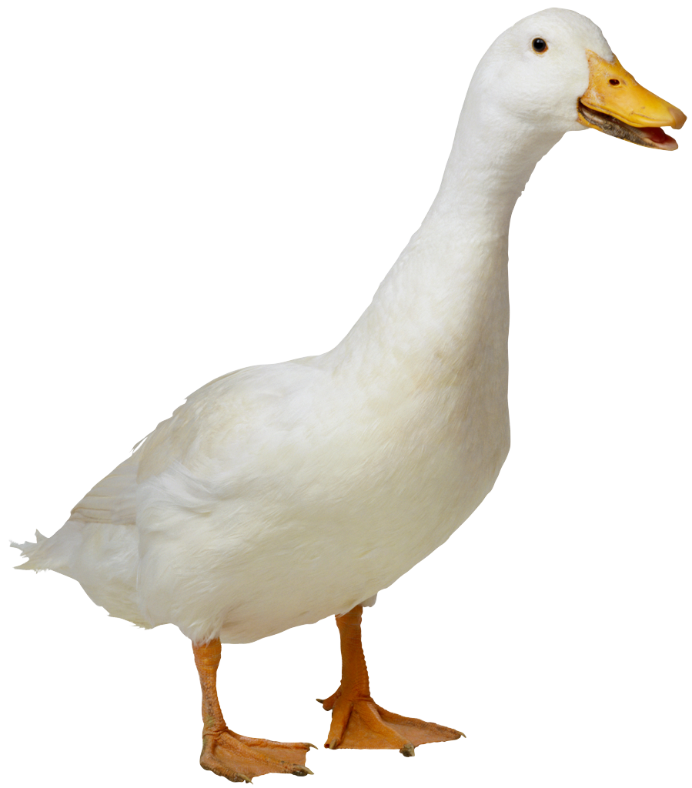
A duck pushes a 5 kg box up a ramp with a 35 (N) force that is parallel to the ramp. Find the acceleration of the box and the normal force on the box. Ignore friction.
θ = 40º
N
1. Draw a Free Body Diagram, draw and label all forces acting on it
F
+y
2. Indicate coordinate system, put one axis in direction of acceleration
mg
θ
+x
3. Write ΣF = ma for each direction
Try to solve for F and m given a = 0.7 m/s² and N = 37.5 (N)
4. Solve for unknowns, substitute given quantities

