Slide 1
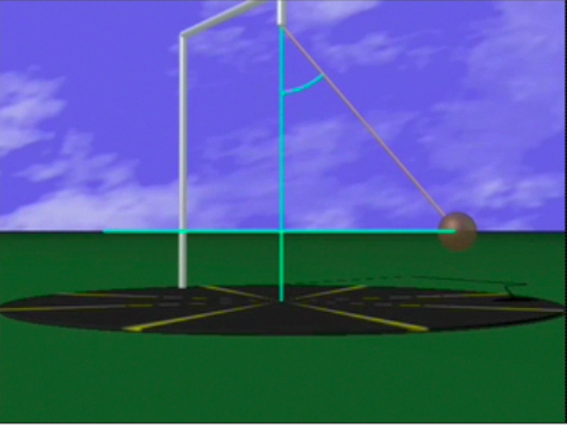
Conical Pendulum
θ
L
Find the Period ( ) of a conical pendulum with m = 2.5 kg, θ = 20º, L = 1.5 m
r
+y
θ
T
+x
mg
If you can do this on your own you are a conical pendulum master!

