Slide 1
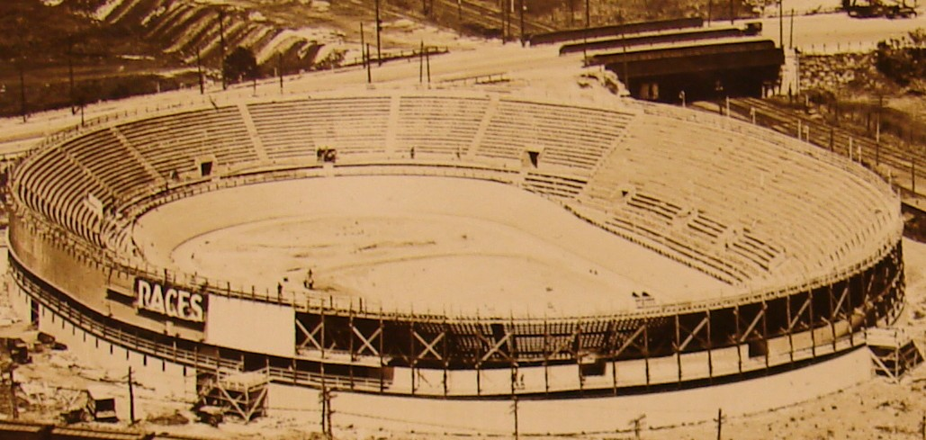
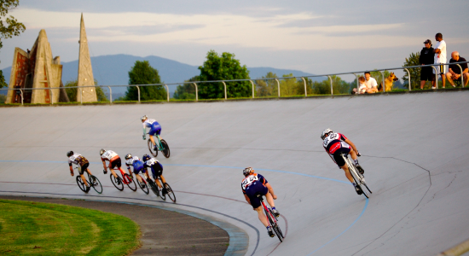
Banked Turns
Banked turn with no friction
m = 1000 kg, r = 20 m, θ = 20º
What v should car have?
v
N
+y
r
mg
+x
θ
N ≠ mgcosθ because there is a component of acceleration in the normal direction

Slide 2
Banked Turns
What if car goes faster than 8.4 m/s? Need friction to keep it from sliding up banked turn
Static friction acts parallel to and down the banked turn
N
What if car goes slower than 8.4 m/s? Need friction to keep it from sliding down banked turn
+y
v
f_{s}
r
mg
+x
Static friction acts parallel to and up the banked turn
θ
N
f_{s}
+y
mg
+x
Not easy to solve for v_{max} or v_{min} on banked turns with friction

