Slide 1
How High is this Diving Board?
A Problem in Astrodynamics
Dan Burns
Inspired by the Non Sequitur Cartoon from October 14, 2012
https://www.gocomics.com/nonsequitur/2012/10/14

Slide 3
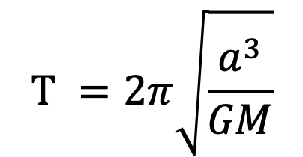
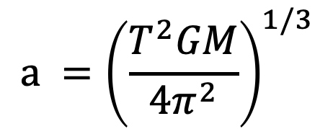
Imagine an elliptical orbit that is so stretched out that it appears to be a line.
This is a linear orbit, the distance to fall is twice the semi-major-axis (a) of this orbit. (Earth’s radius is negligible)
The time to fall from the diving board is half the period
$$T =2π\sqrt{\frac{a^{3}}{GM}}$$
$$a ={\left(\frac{T^{2}GM}{4π^{2}}\right)}^{1/3}$$
$M=5.97×{10}^{24}$kg
$$x=2a$$
$$G=6.67×{10}^{−11}\frac{m^{3}}{{kg∙s}^{2}}$$
$T=2∙80 yr∙\frac{365.24d}{yr}∙\frac{24hr}{d}∙\frac{3600s}{hr}=5.05×{10}^{9}$s
$$x=2{\left(\frac{{{(5.05×10}^{9})}^{2}∙6.67×{10}^{−11}∙5.97×{10}^{24}}{4π^{2}}\right)}^{1/3}=$$
$$x=1.27×{10}^{11}m=78,914,000 miles!$$
Assuming Earth’s gravity is only factor
http://www.motleytech.net/falling-into-the-sun.html

Slide 4
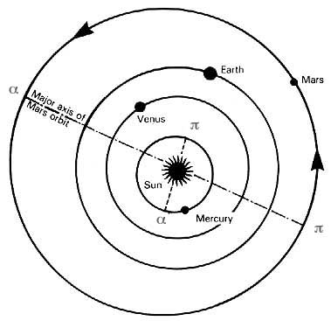
$$x=1.27×{10}^{11}m=0.85 AU$$

