Slide 1
All I Ever Needed to Know About Physics I Learned from Road Runner Cartoons

Slide 2
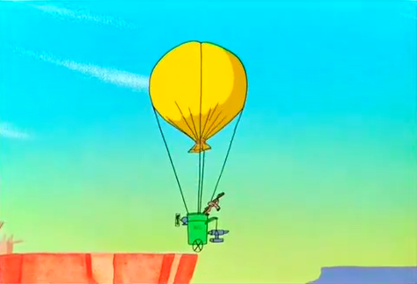
Boy, Am I In Trouble!

Slide 3
What Eats Roadrunners?
Notes:
Insert Intro movie here

Slide 4
Is This Possible? Why or why not?
Notes:
Insert RollingBoulder movie here

Slide 5
How about this? Why or why not?
Notes:
Insert HumanCannonball movie here

Slide 6
What would be the effect of adding a second fan?
Notes:
Insert FanPoweredSail movie here

Slide 7
What are the good and bad physics of this?
Notes:
Insert GiantRubberBand movie here

Slide 8
What are the good and bad physics of this?
Notes:
Insert BallAnvil movie here

Slide 9
The Cartoon Laws of Physics:
Any body suspended in space will remain in space until made aware of its situation.
Everything falls faster than an anvil.
All principles of gravity are negated by fear.
As speed increases, objects can be in several places at once.
Any body passing through solid matter
will leave a perforation conforming to its perimeter.

Slide 10
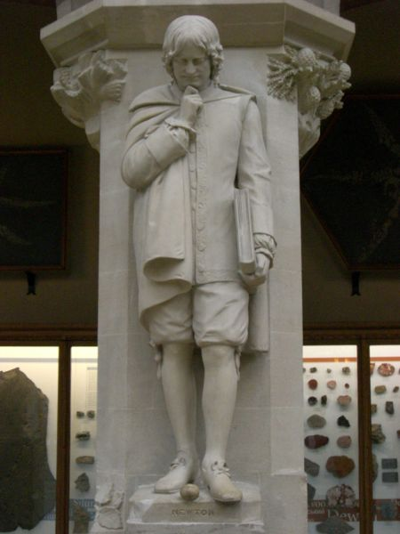
The Real Laws of Physics:
Newton’s Laws of Motion
Conservation of Energy
Conservation of Momentum
Conservation of Angular Momentum
Newton’s Universal Law of Gravity

Slide 11
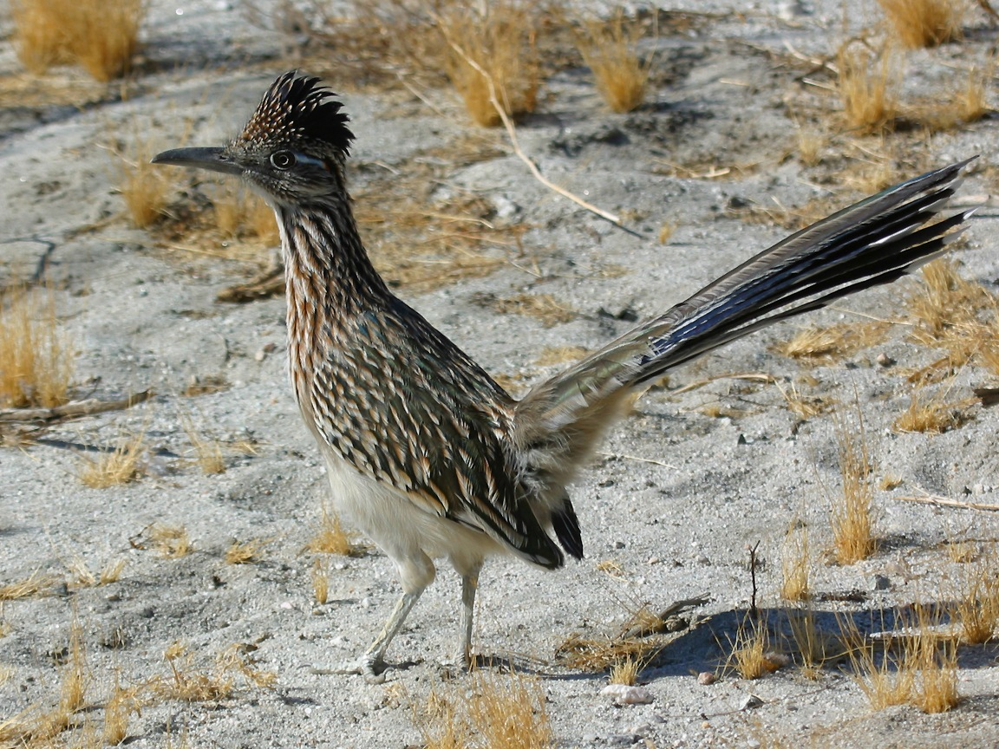
Roadrunner fun facts
Roadrunners are prey for hawks, house cats, raccoons, snakes, and skunks, not coyotes!
Roadrunners can attain speeds of 17 mph.
The roadrunner makes a series of dovelike coos dropping in pitch, as well as a clattering sound.
It reabsorbs water from its feces before excretion.
A roadrunner can catch a rattlesnake by the tail, crack it like a whip and repeatedly slam its head against the ground till dead
Its extreme quickness allows it to snatch a humming bird or dragonfly from midair.
Rattlesnake video: https://youtu.be/3s1HGB1vKNE

